Slide 1

DESCRIBING THE PROBLEM

Slide 2
❏ WHAT IS THE BUSINESS PROBLEM?
❏ WHO ARE THE STAKEHOLDERS IMPACTED BY THE PROBLEM?
❏ WHY IS THIS PROBLEM IMPORTANT TO THE ORGANIZATION?

Slide 3
❏ WHAT IS THE BUSINESS PROBLEM?
The client's point of view : Should the business owner continue to sell tomato paste or not ?
Our understanding :What can be done to ensure profit and avoid the current systematic loss.

Slide 4
❏ WHO ARE THE STAKEHOLDERS IMPACTED BY THE PROBLEM?
Michel (boutique owner)
His son (who is asked some pieces of advice)
The consumer (Who buy the tomato paste)
The suppliers (The producer, the delivery guy)

Slide 5
❏ WHY IS THIS PROBLEM IMPORTANT TO THE ORGANIZATION?
This problem is important to the organization because it is affecting the organization profit negatively.
Mr. Michel has invested in his store in order to sell tomatoes
It is threatening the organization existence

Slide 6
METHODOLOGY USED FOR THE ANALYSIS

Slide 7
❏ METHODS, DATA SOURCES, AND CHOICE OF VARIABLES. ❏ HOW THEY WILL HELP ADDRESSING THE PROBLEM.

Slide 8
METHODS, DATA SOURCES AND CHOICE OF VARIABLES.
WE HAVE USED A DATA SET THAT CONTAINS THE SALES RECORDING OF THE LAST THREE MONTHS.
We used the first-in-first-out method, all inventory calculations were done using this method.
Microsoft Excel is the main software used to process and analyze the data.
A diagnosis of the sales is made for the 3 months.
We have divided the 3 months into 7 periods, each of which starts with the date of an order. Monthly analyses have been made on the sales to understand the profits/losses according to the brands.

Slide 9
HOW THEY WILL HELP ADDRESSING THE PROBLEM.
The method of first entry and first exit allows us to check the quantity of tomatoes sold, lost or remaining for each order. It also allowed us to see if the order was really necessary and to evaluate the profit or loss of the store.

Slide 10
SUMMARIZING THE RESULTS

Slide 11
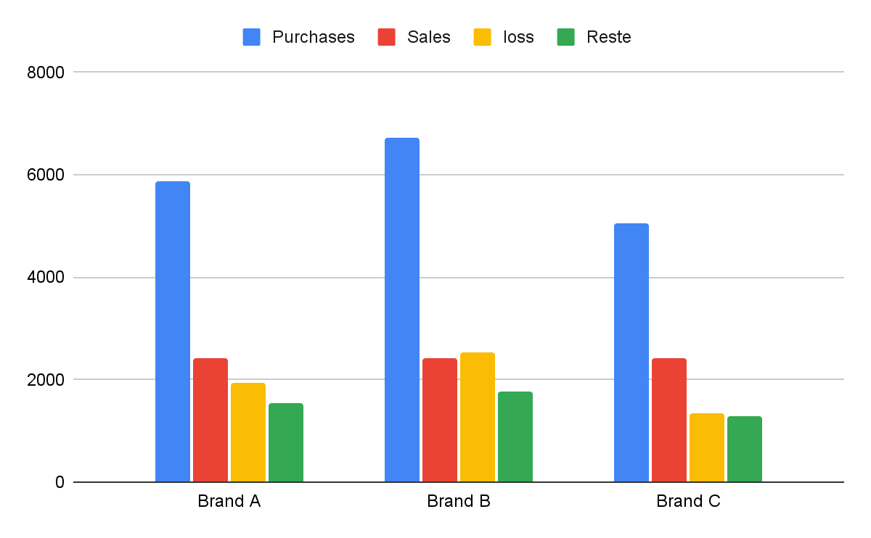
It can be seen that the quantity sold for each Brand is more or less the same as the quantity lost. For the three brands, he manages to sell only 40.9% of his purchases. We can even see that the quantity sold is less than the quantity lost for Brand B. These losses are enormous.

Slide 12
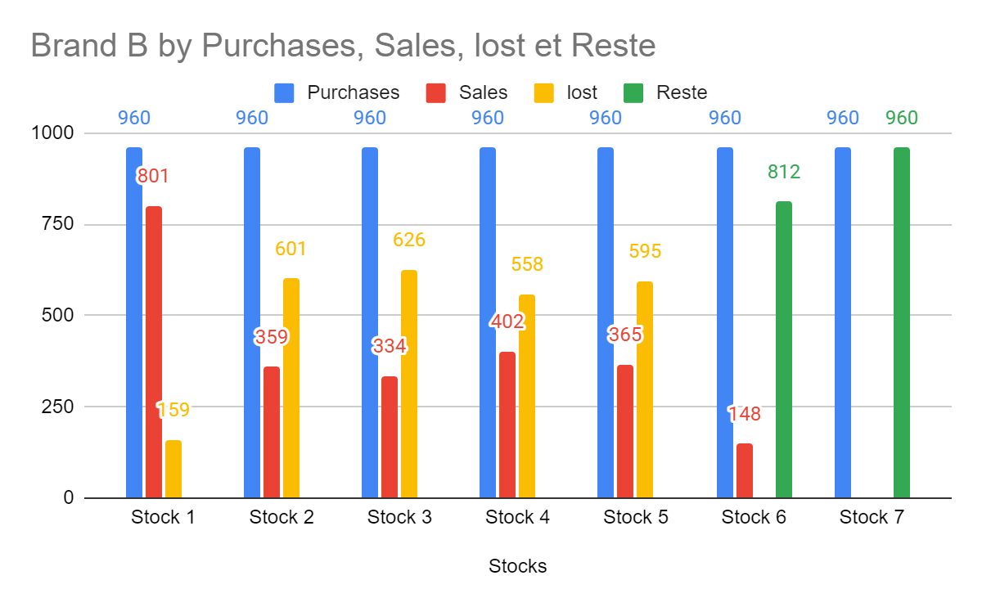
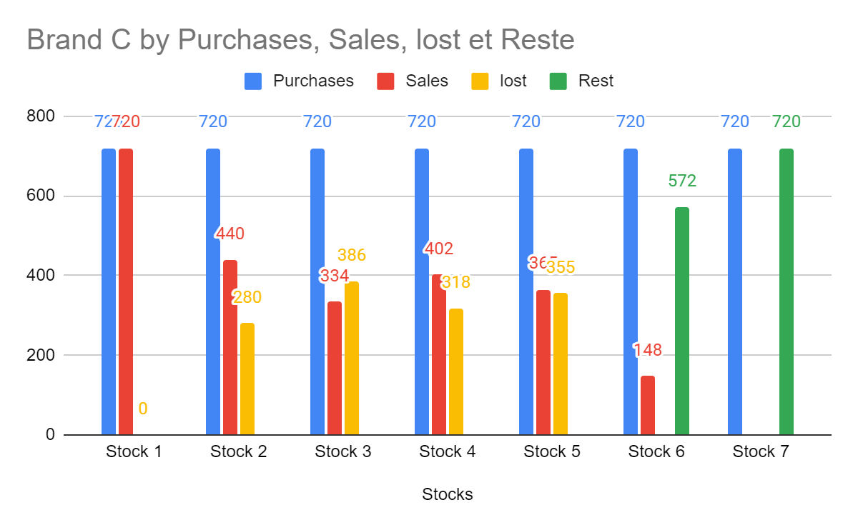
The observation is almost the same for brand C except that generally the total sales volume is higher than the volume of lost goods, which is a positive thing in itself. However the problem of buying the merchandise too often persists. And that plays a great role in the general problem the boutique is facing.
We observe the same thin from a in b

Slide 13
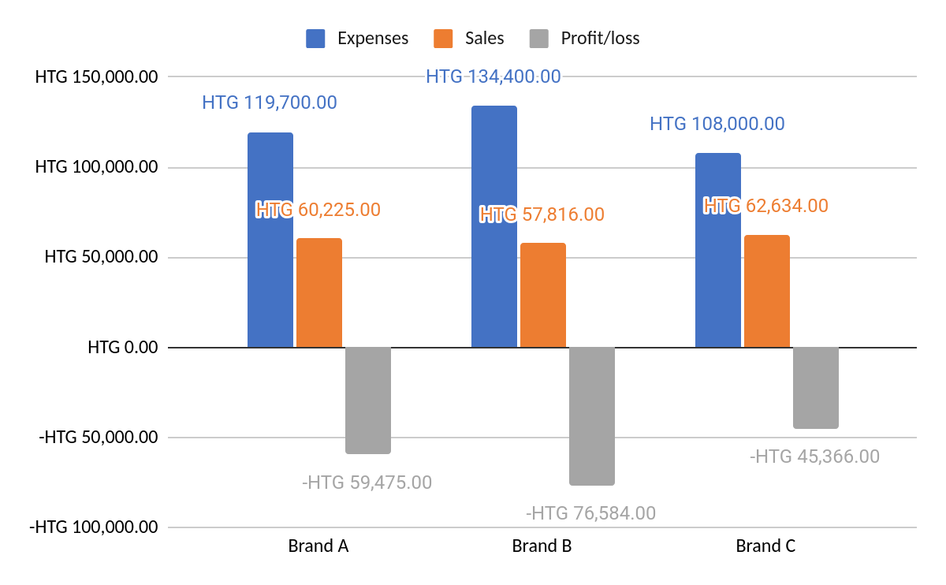
The above chart shows the sales for each fixed period according to the date of the orders, the quantity of cans sold does not exceed 403 for any period. However, Michele regularly places orders for 840, 960 and 720 for B and C respectively.
He is obliged to sell his products before the end of the month, otherwise he will not be able to sell them. This constraint creates consequences that Michele will have to suffer deeply, the following graph is a good illustration for Brand A.

Slide 14
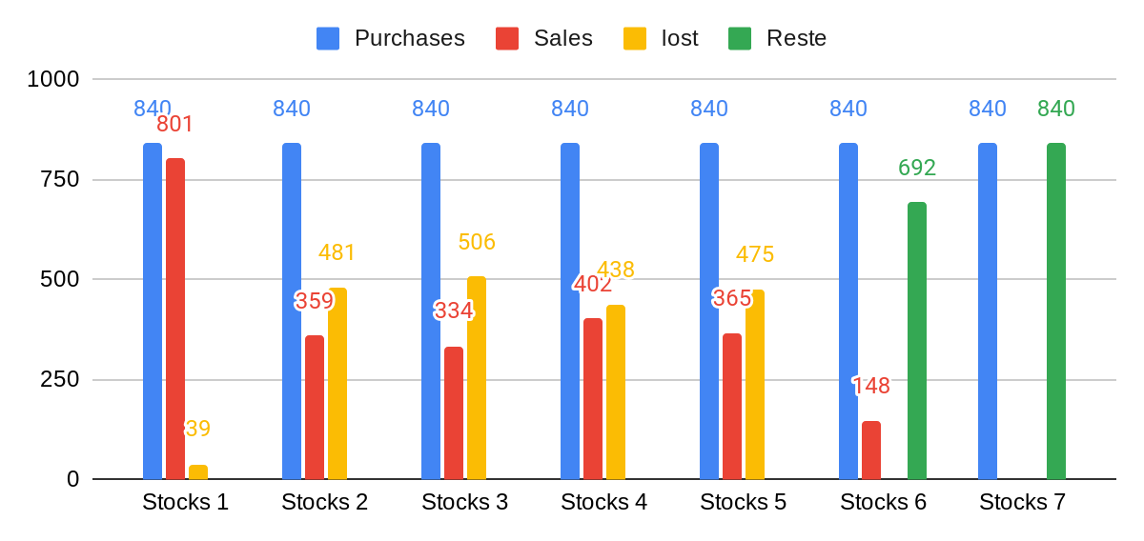
Paste tomato-A Purchases, Sales, Lost, Stock.
From the graph above, we can see that the losses are systematically higher than the sales since Michele does not wait for the end of the stock to order another one. However the products expire after 1 month. While there were 692 remaining cans of tomatoes, he decided to increase his stock by 840 cans. In the end, the only order that is profitable for him is the first one. This does not correspond to any management logic.

Slide 15
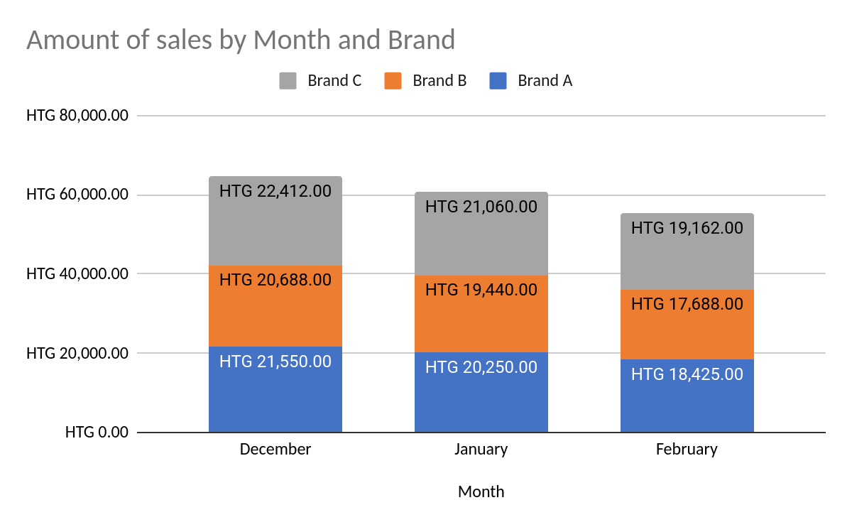
For Brand C, the sale went from 22,412 gourdes to 19,162 gourdes, a decrease of just under 5%. However, despite this drop, Michele did not vary his orders. The same is true for Brand B, where sales have dropped from 20,688 gourdes to 17,688 gourdes. The demand is continuously decreasing, and a response is needed to adapt the orders and the stock to the new market dynamics

Slide 16
PROPOSED SOLUTIONS

Slide 17
❏ WHAT IS YOUR PROPOSED SOLUTION? ❏ WHAT ARE STRENGTHS OF THE ORGANIZATION THAT YOU HAVE LEVERAGED IN YOUR SOLUTION? ❏ WHAT ARE WEAKNESSES OF THE ORGANIZATION THAT COULD UNDERMINE YOUR SOLUTION? ❏ WHAT ARE CHALLENGES THAT YOU MIGHT ENCOUNTER? HOW CAN YOU MITIGATE THEM?

Slide 18
SOLUTION 1
1) Liquidate the remaining products in order to avoid the potential loss.
2) Reduce the amount of tomato paste ordered. 3) Order tomato paste monthly instead of bi-weekly.

Slide 19
WHAT ARE STRENGTHS/WEAKNESS OF THE ORGANIZATION THAT CAN INFLUENCE THE SOLUTION
Strength: This solution will allow Michel to reduce his losses automatically and sooth their rhythm, by attempting to make at least zero profits on his last stocks instead of negative profits.
Weakness: The clients might still not want to place more orders as the price of liquidation is set at the cost of acquisition

Slide 20
WHAT ARE CHALLENGES THAT YOU MIGHT ENCOUNTER? HOW CAN YOU MITIGATE THEM?
Time (how long?): This solution will take, at most, one month to complete, since the tomato paste he has in stock cannot be sold at all after one month.
Expected cost for implementing the solution: Michel will have to wait at most one month. He will not spend any more money to get the solution implemented, and he won’t have to hire any special new staff to liquidate the products for him.

Slide 21
SOLUTION 2
Another solution to the problem consists of running a market analysis to understand the demand for tomato paste.
The market analysis will help him understand his competition, understand his clients better, gather more information.

Slide 22
STRENGTHS
- Unlimited stock of products
- Sale different tomato brands
- Regular supplying

Slide 23
❏ WHAT ARE CHALLENGES THAT YOU MIGHT ENCOUNTER? HOW CAN YOU MITIGATE THEM?
To run the market analysis, the business owner needs to spend money.
He may not be interested In that solution because he is already loosing money.
I would advice him to consider the market solution as an investment in order to make more money in he future or avoid loosing more money.

Slide 24
PRESENTING TEAM MEMBERS
KETENIE FLORE THÉNÉUS
RAPHAEL MIKA BONY II ALEXANDRE
WEDSANLEY JEAN PHILIPPE

